Slide 1
Welcome
You should be here if:
  You will be graduating in 2014 (specifically September 2014) AND
  You have not previously submitted a license application to the License Department

Slide 2
“What does the NMC do for you to get a Credential?”
Receive the application package from Academy.
Determine if the application package is “ready for evaluation”. Ship in bulk to Special Academy Team at NMC.
If critical pieces of the application package are missing, (i.e. evaluation can not begin without them) Applications are returned to the Academy.
  Note: If this becomes necessary, this could potentially add 1-2 additional weeks to the overall evaluation process time. Credentials may not be available at time of graduation.

Slide 3
Check for mariner contact information and phone number
Check for next of kin information
Spell out exactly what endorsements the mariner is asking for.
If application is not complete, DO NOT SEND
Can’t accept the application without it!

Slide 4
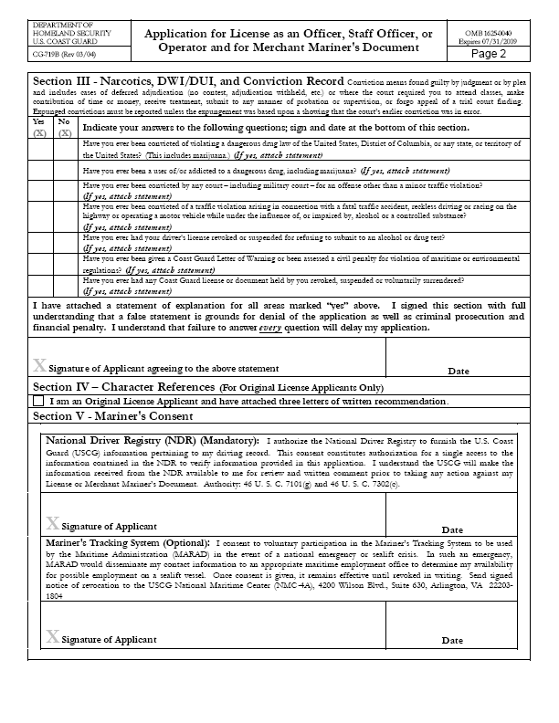
Written statement (who, what, where, when, and why) to any applicable “yes” answers and anything that pertains to the convictions i.e. court documentation
Original App: ALL Convictions.
Check for signatures, where appropriate, and dated
Conviction
Statement
Can’t accept the application without it!

Slide 5
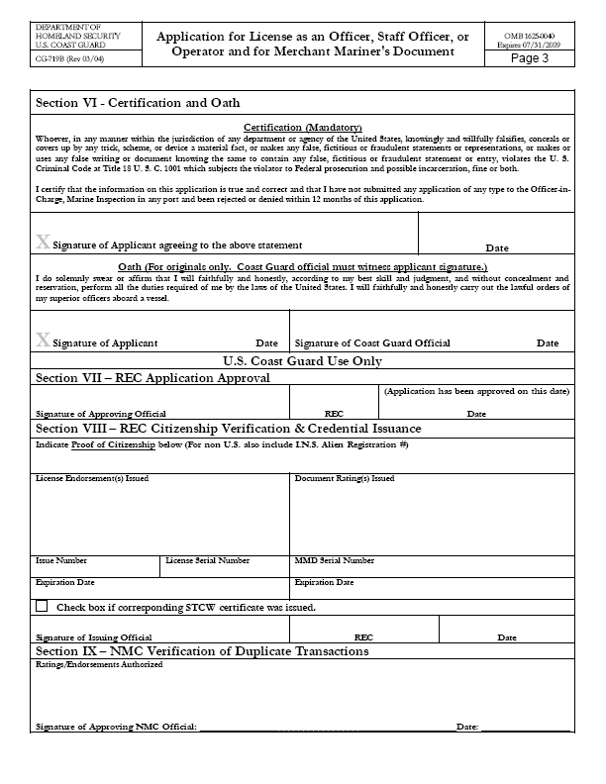
Check for signatures, where appropriate, and dated
If original, check for oath signed and dated
Can’t accept the application without it!
Sample Oath

Slide 6
R e f e r e n c e s
Character
Each applicant for an original officer or STCW endorsement must submit written recommendations concerning the applicant's suitability for duty from a master and two other individuals holding officer endorsements or licenses on vessels on which the applicant has served.
As part of the approved 310 program with MARAD and the USCG, SUNY Maritime College will submit the Character Reference Letter with signatures from the Commandant of Cadets, Department Chair, and department training officer.

Slide 7
Merchant Mariner
Physical Examination Report
(CG-719K & K/E)
The revised CG 719K and 719K/E forms more clearly align the Merchant Mariner Credentialing process with the guidelines set forth by:
Navigation and Vessel Inspection Circular 04-08 (NVIC), MEDICAL AND PHYSICAL EVALUATION GUIDELINES FOR MERCHANT MARINER CREDENTIALS.
Mariners and physicians are highly encouraged to use NVIC 04-08 in conjunction with the new physical examination forms.

Slide 8
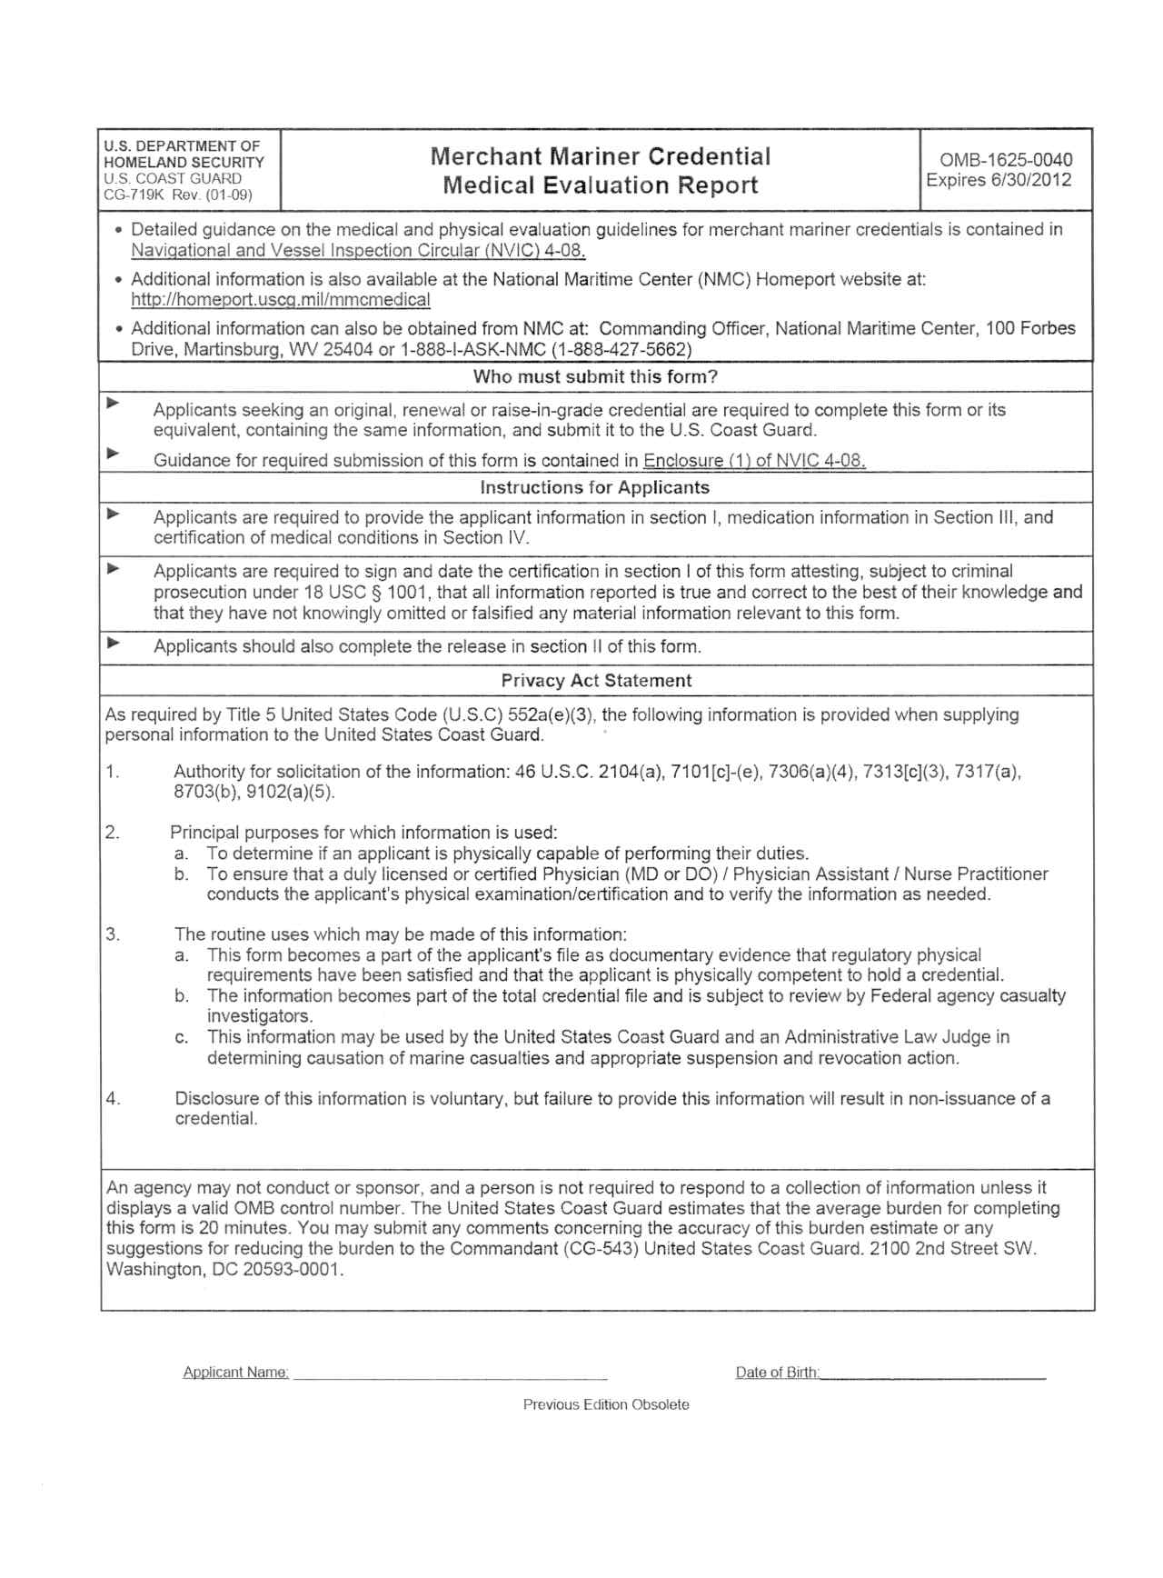
MANDATORY:
Ensure all blocks are completed!
Signed and dated (within 12months) by physician
If missing any of the above, DO NOT SEND
Can’t accept the application without it!

Slide 9
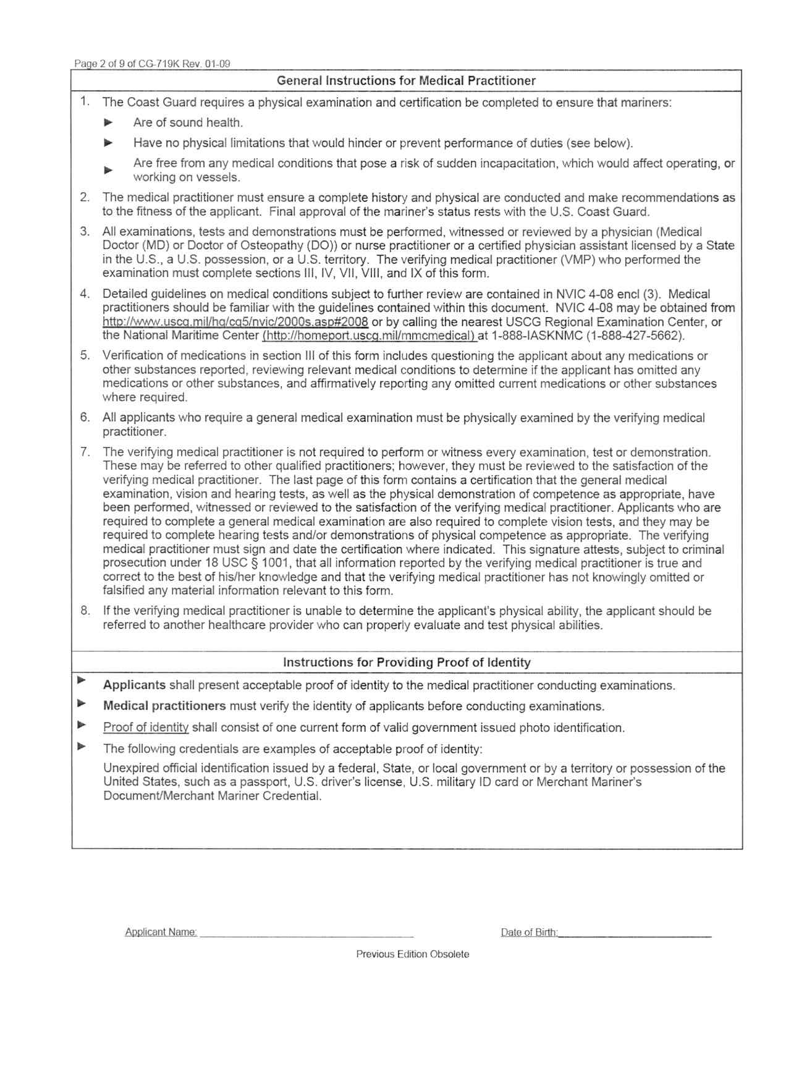
MANDATORY:
Ensure all blocks are completed!
Signed and dated (within 12months) by physician
If missing any of the above, DO NOT SEND
Can’t accept the application without it!

Slide 10
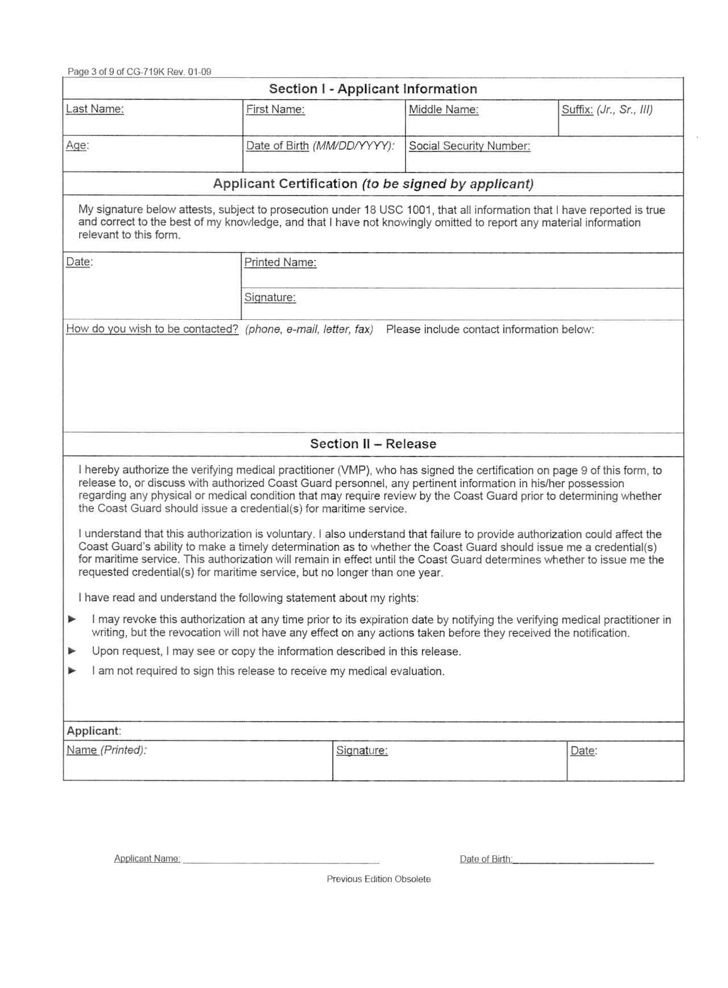
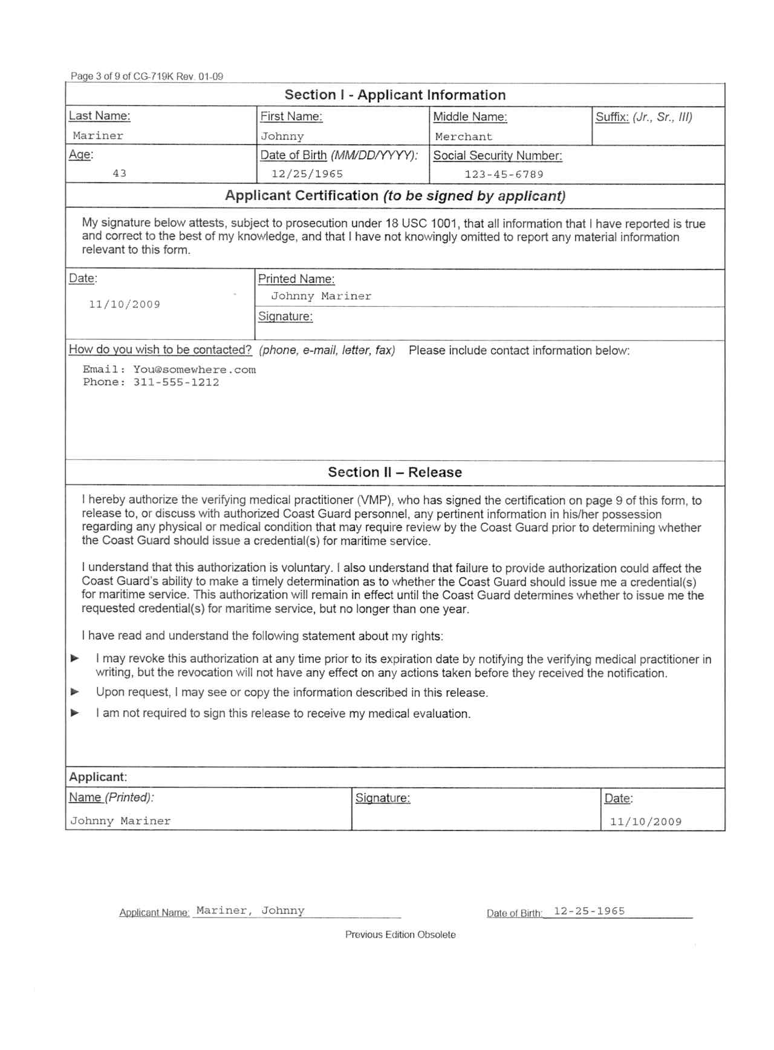
MANDATORY:
Ensure all blocks are completed!
Johnny Mariner
Signed and dated (within 12months) by physician
If missing any of the above, DO NOT SEND
Can’t accept the application without it!
Johnny Mariner

Slide 11
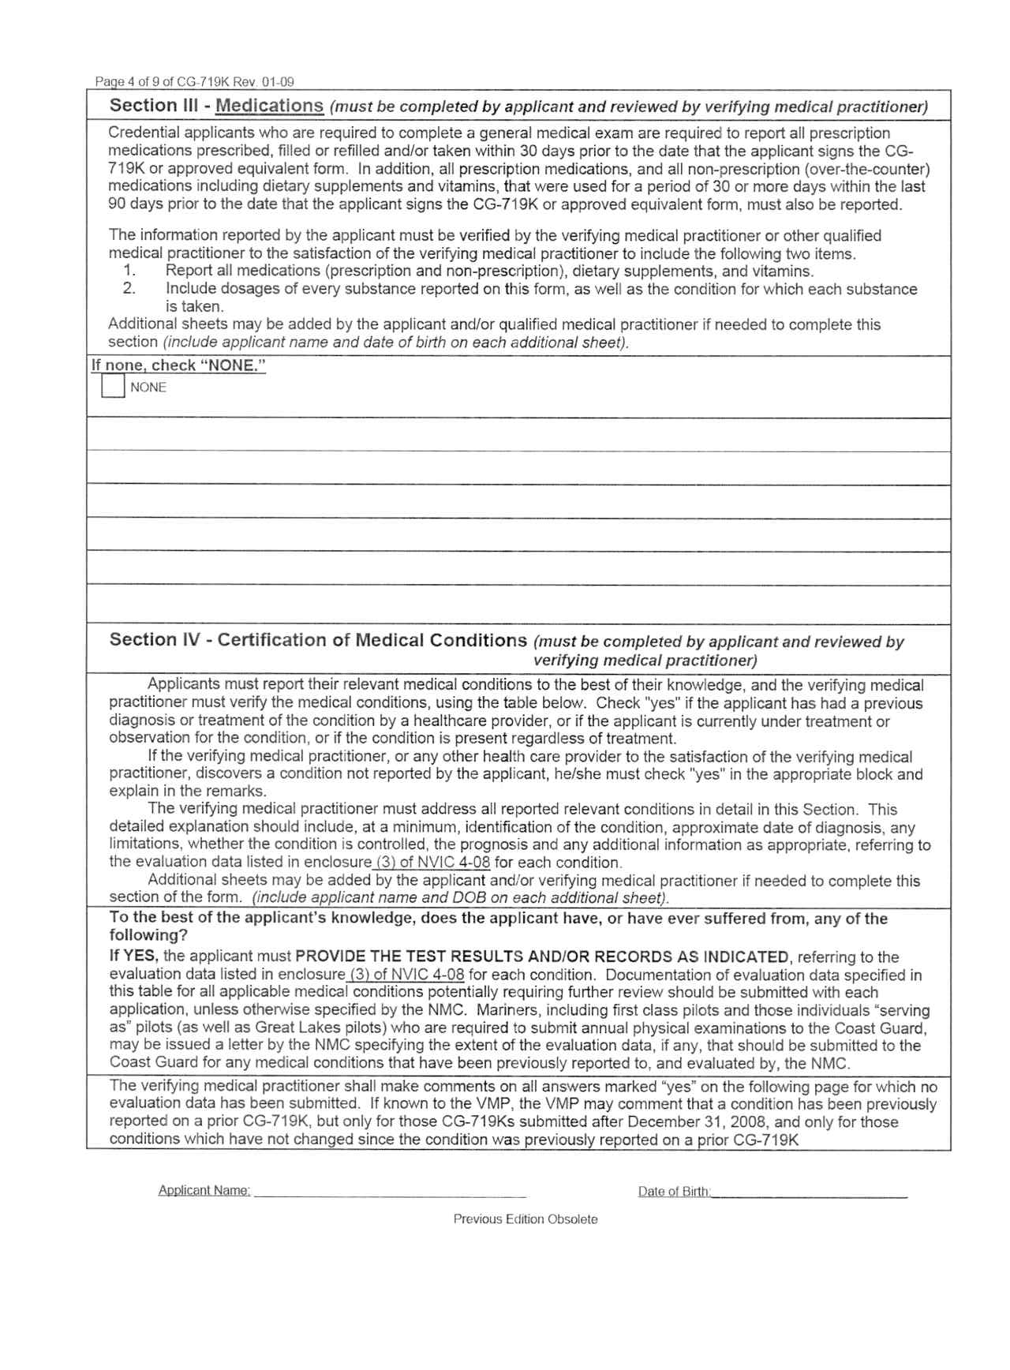
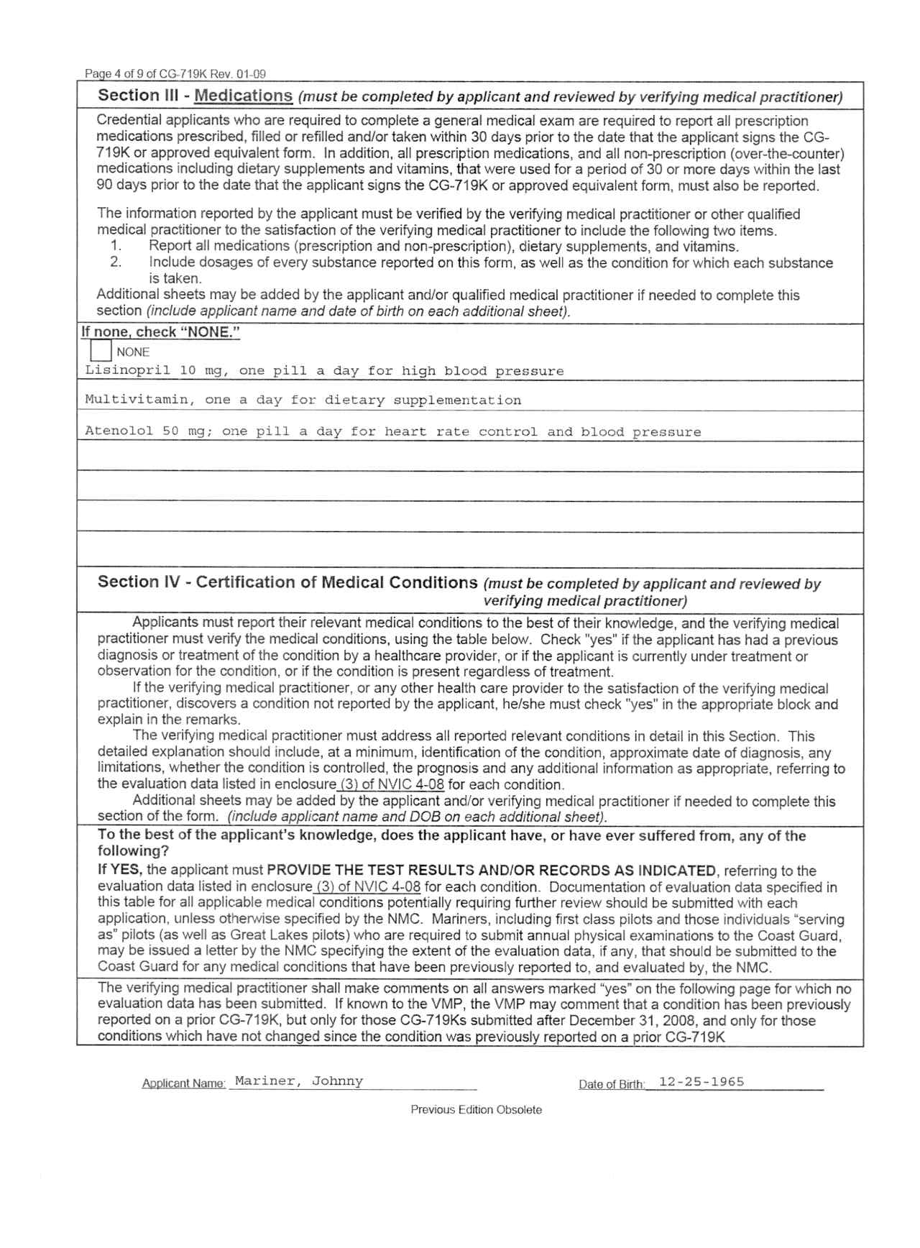
MANDATORY:
Ensure all blocks are completed!
Signed and dated (within 12months) by physician
If missing any of the above, DO NOT SEND
Can’t accept the application without it!

Slide 12
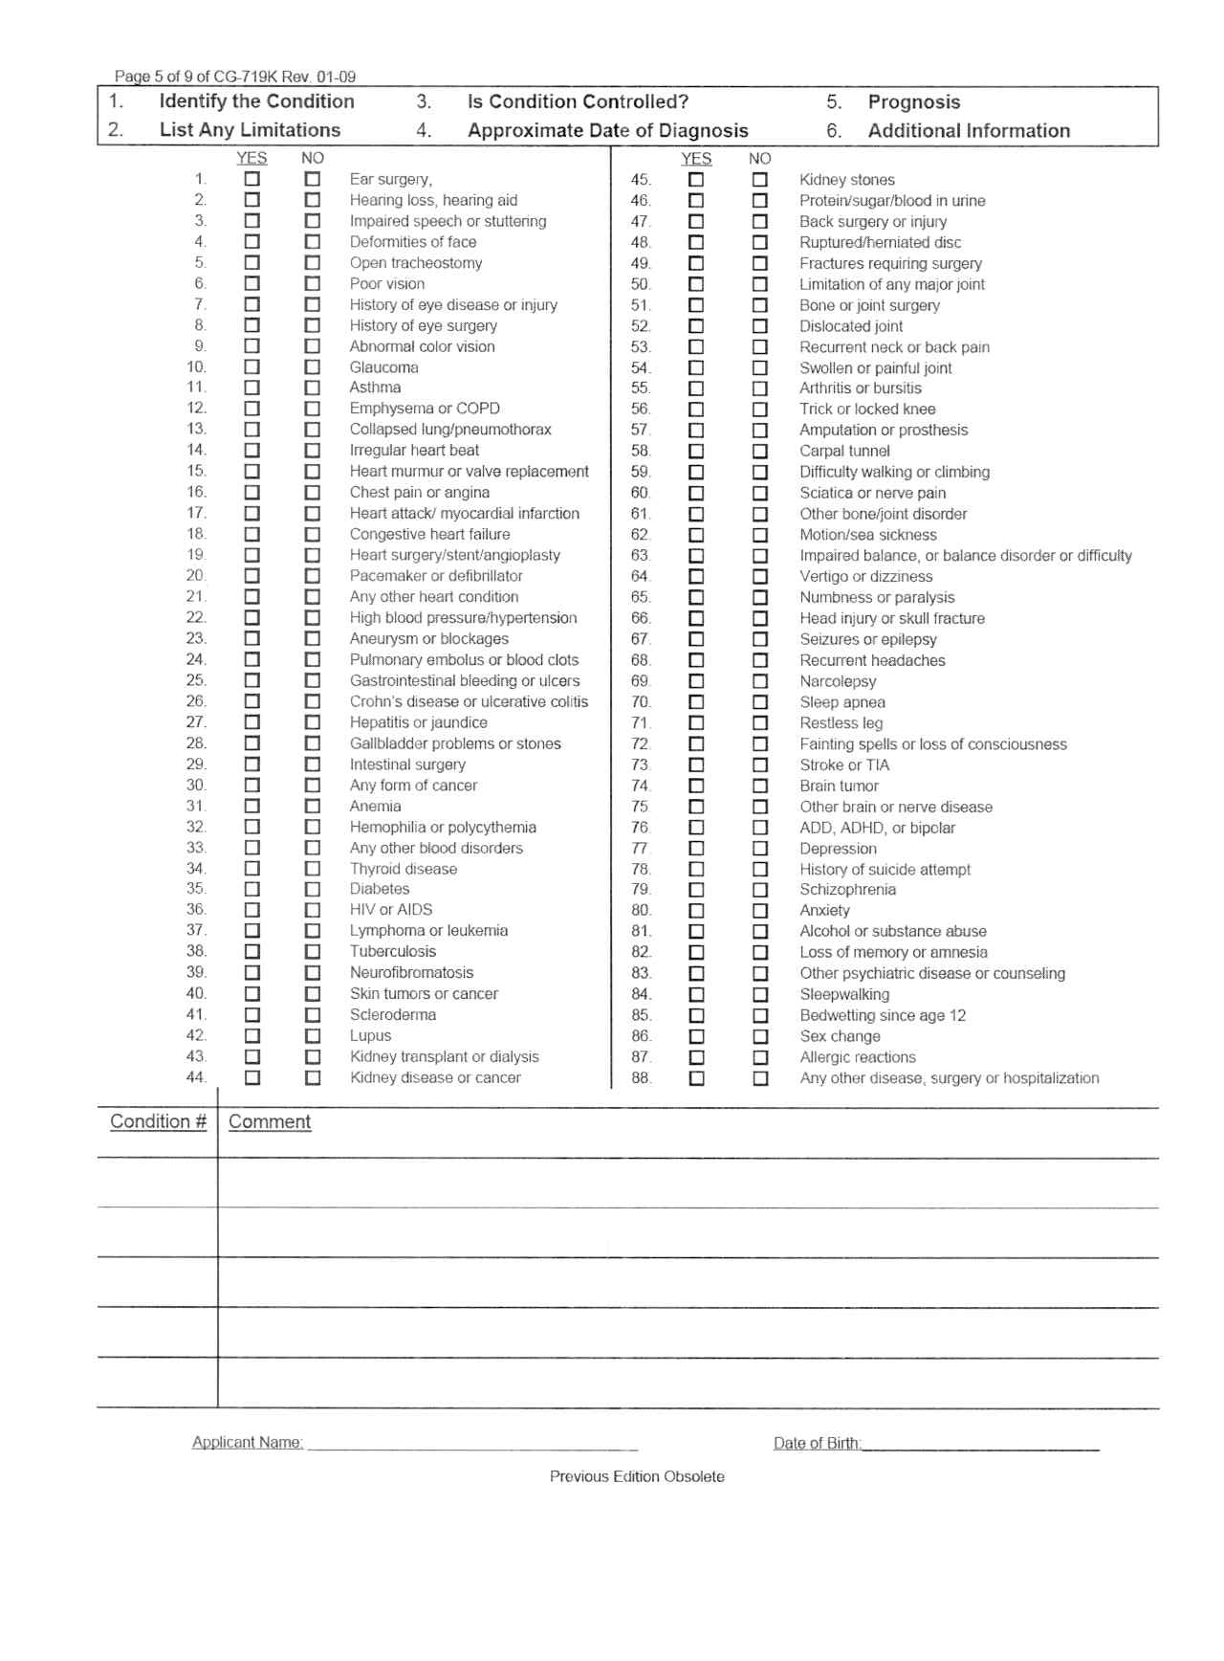
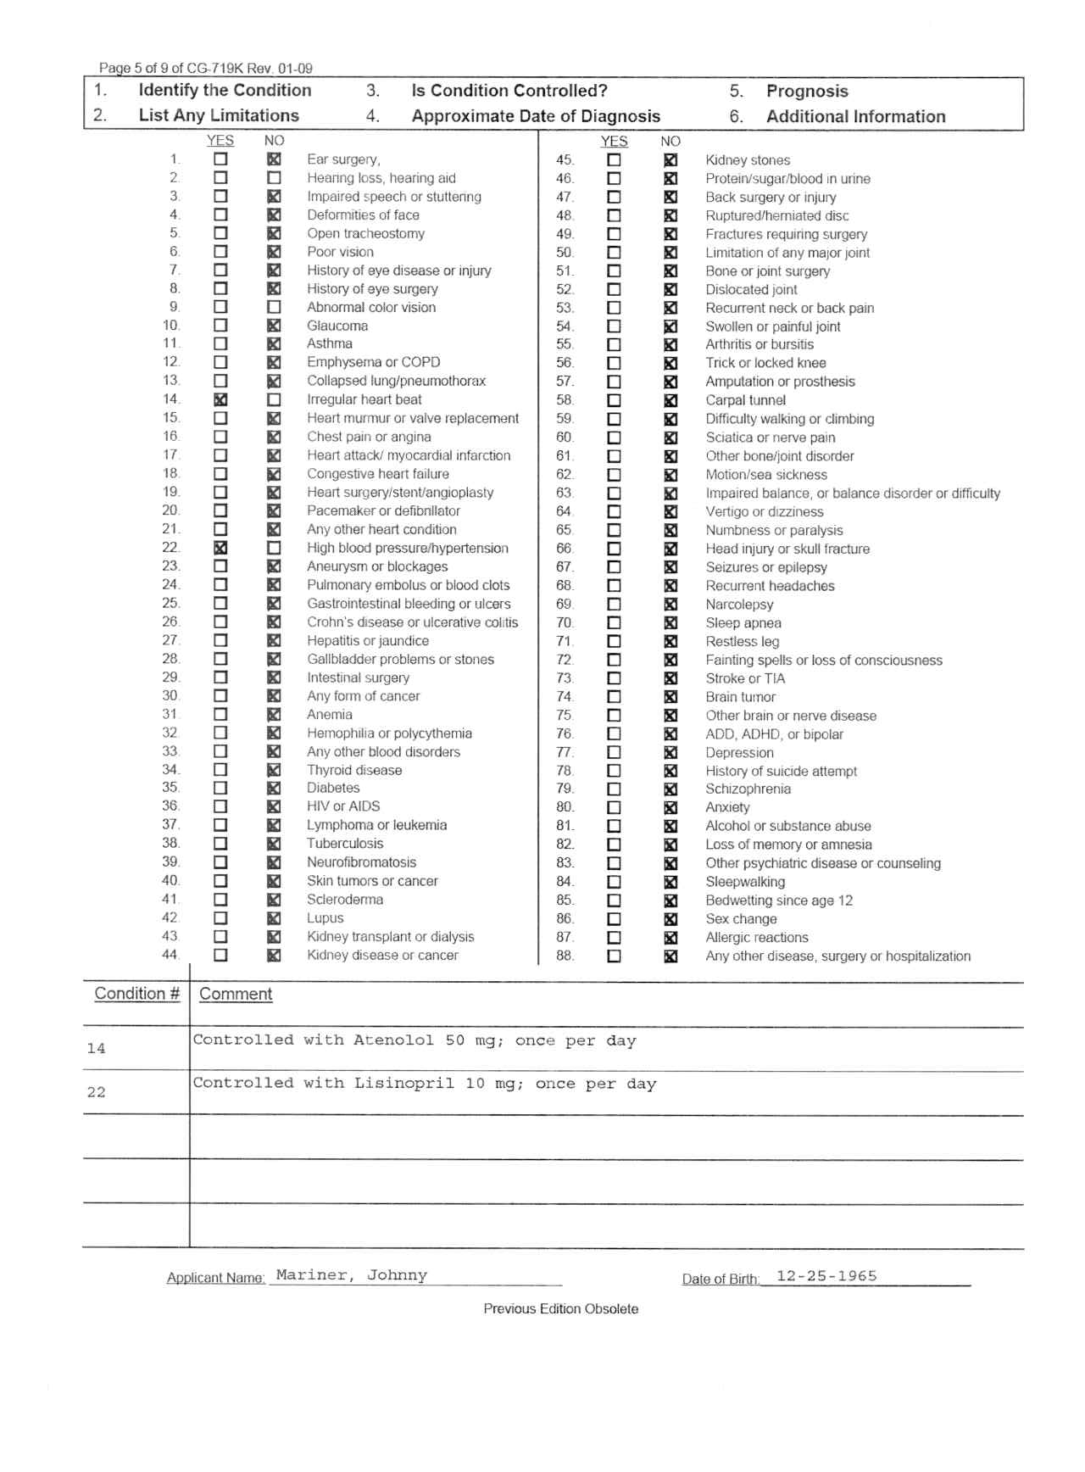
MANDATORY:
Ensure all blocks are completed!
Signed and dated (within 12months) by physician
If missing any of the above, DO NOT SEND
Can’t accept the application without it!

Slide 13
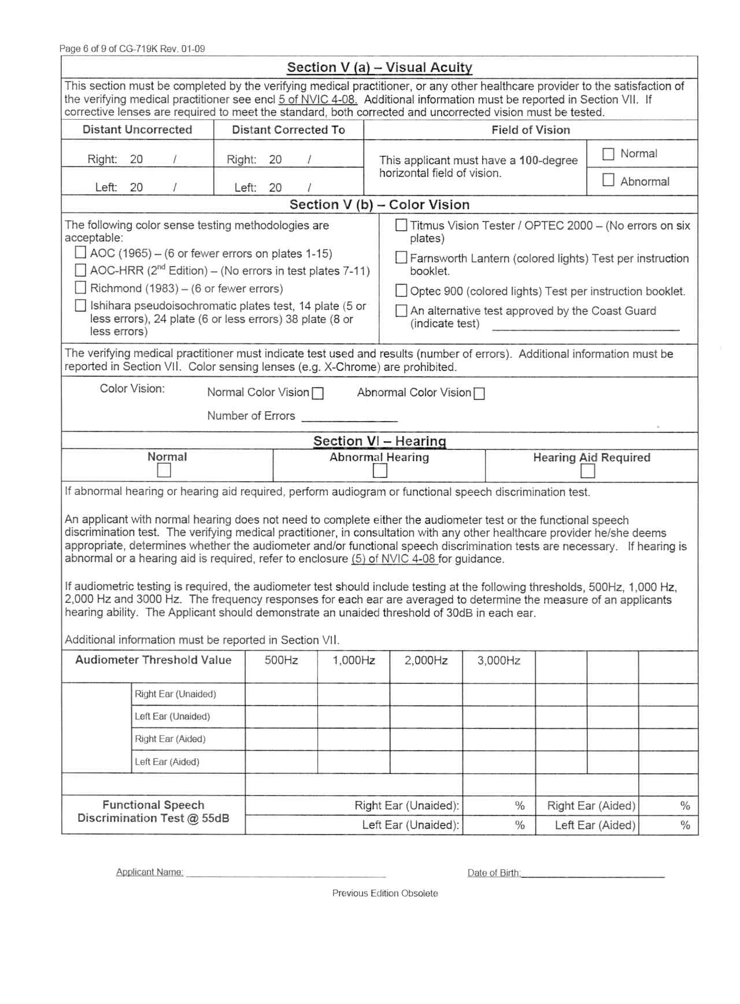
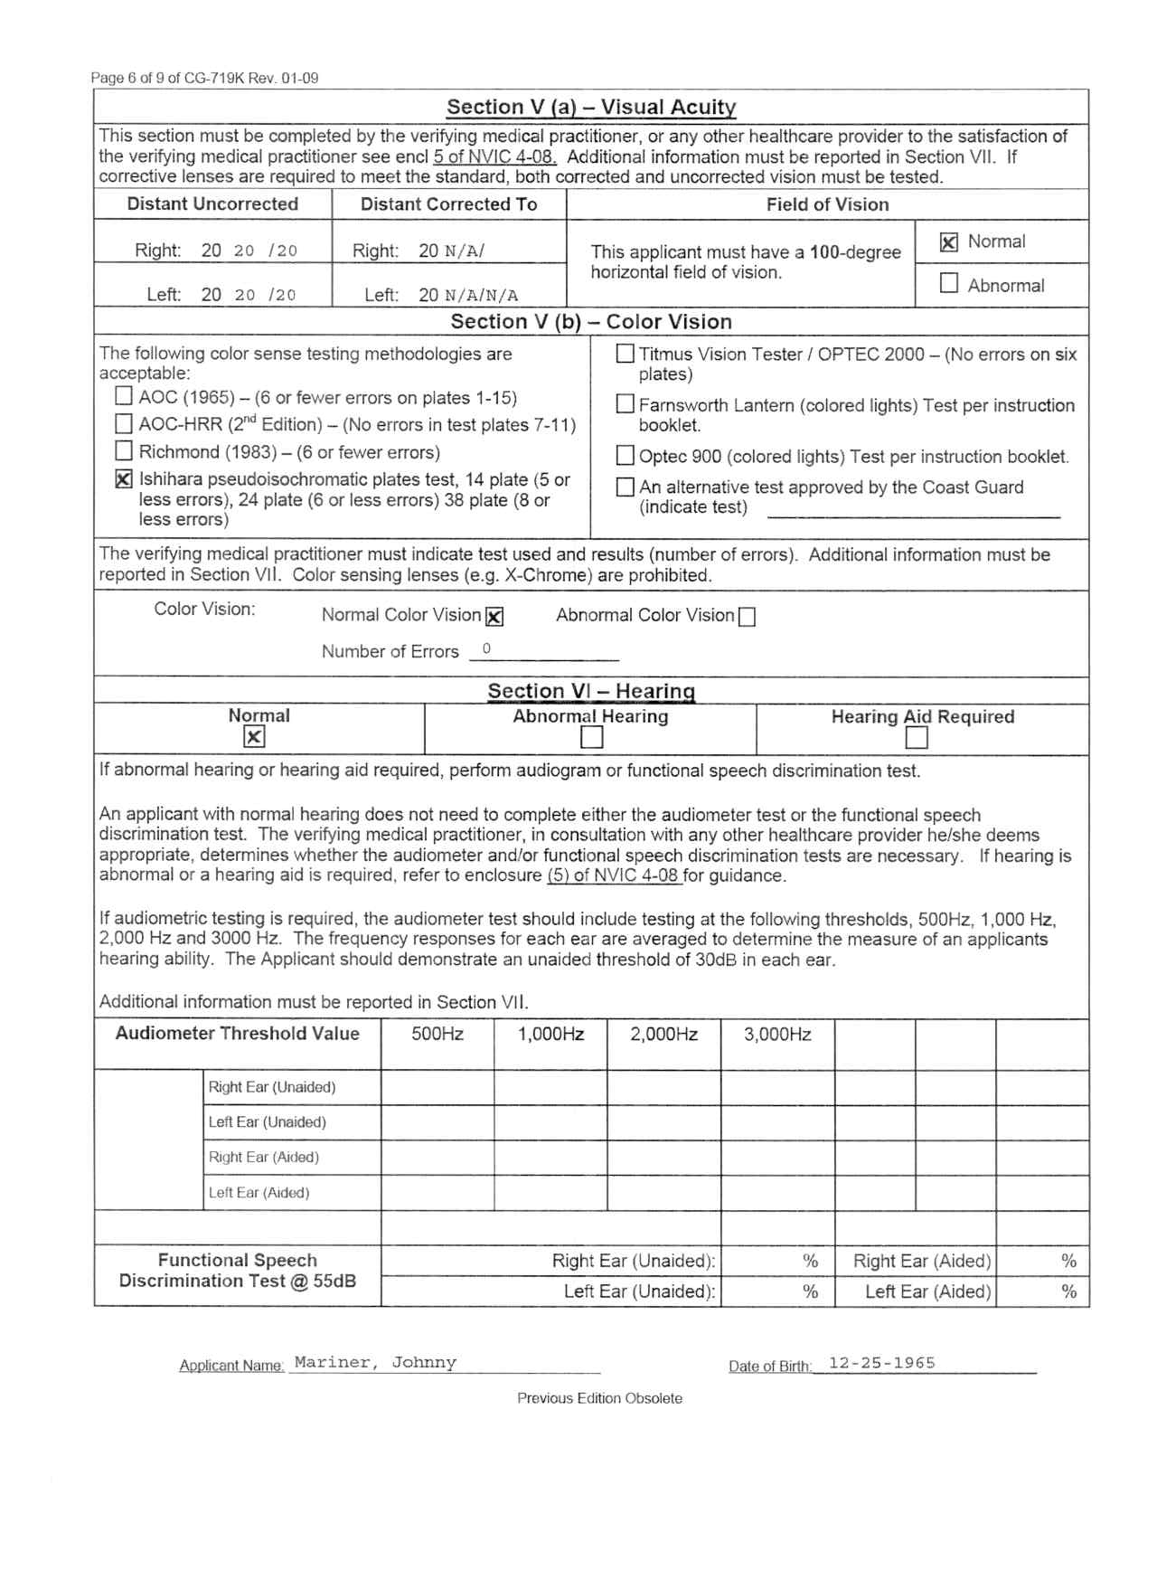
MANDATORY:
Ensure all blocks are completed!
Signed and dated (within 12months) by physician
If missing any of the above, DO NOT SEND
Can’t accept the application without it!

Slide 14
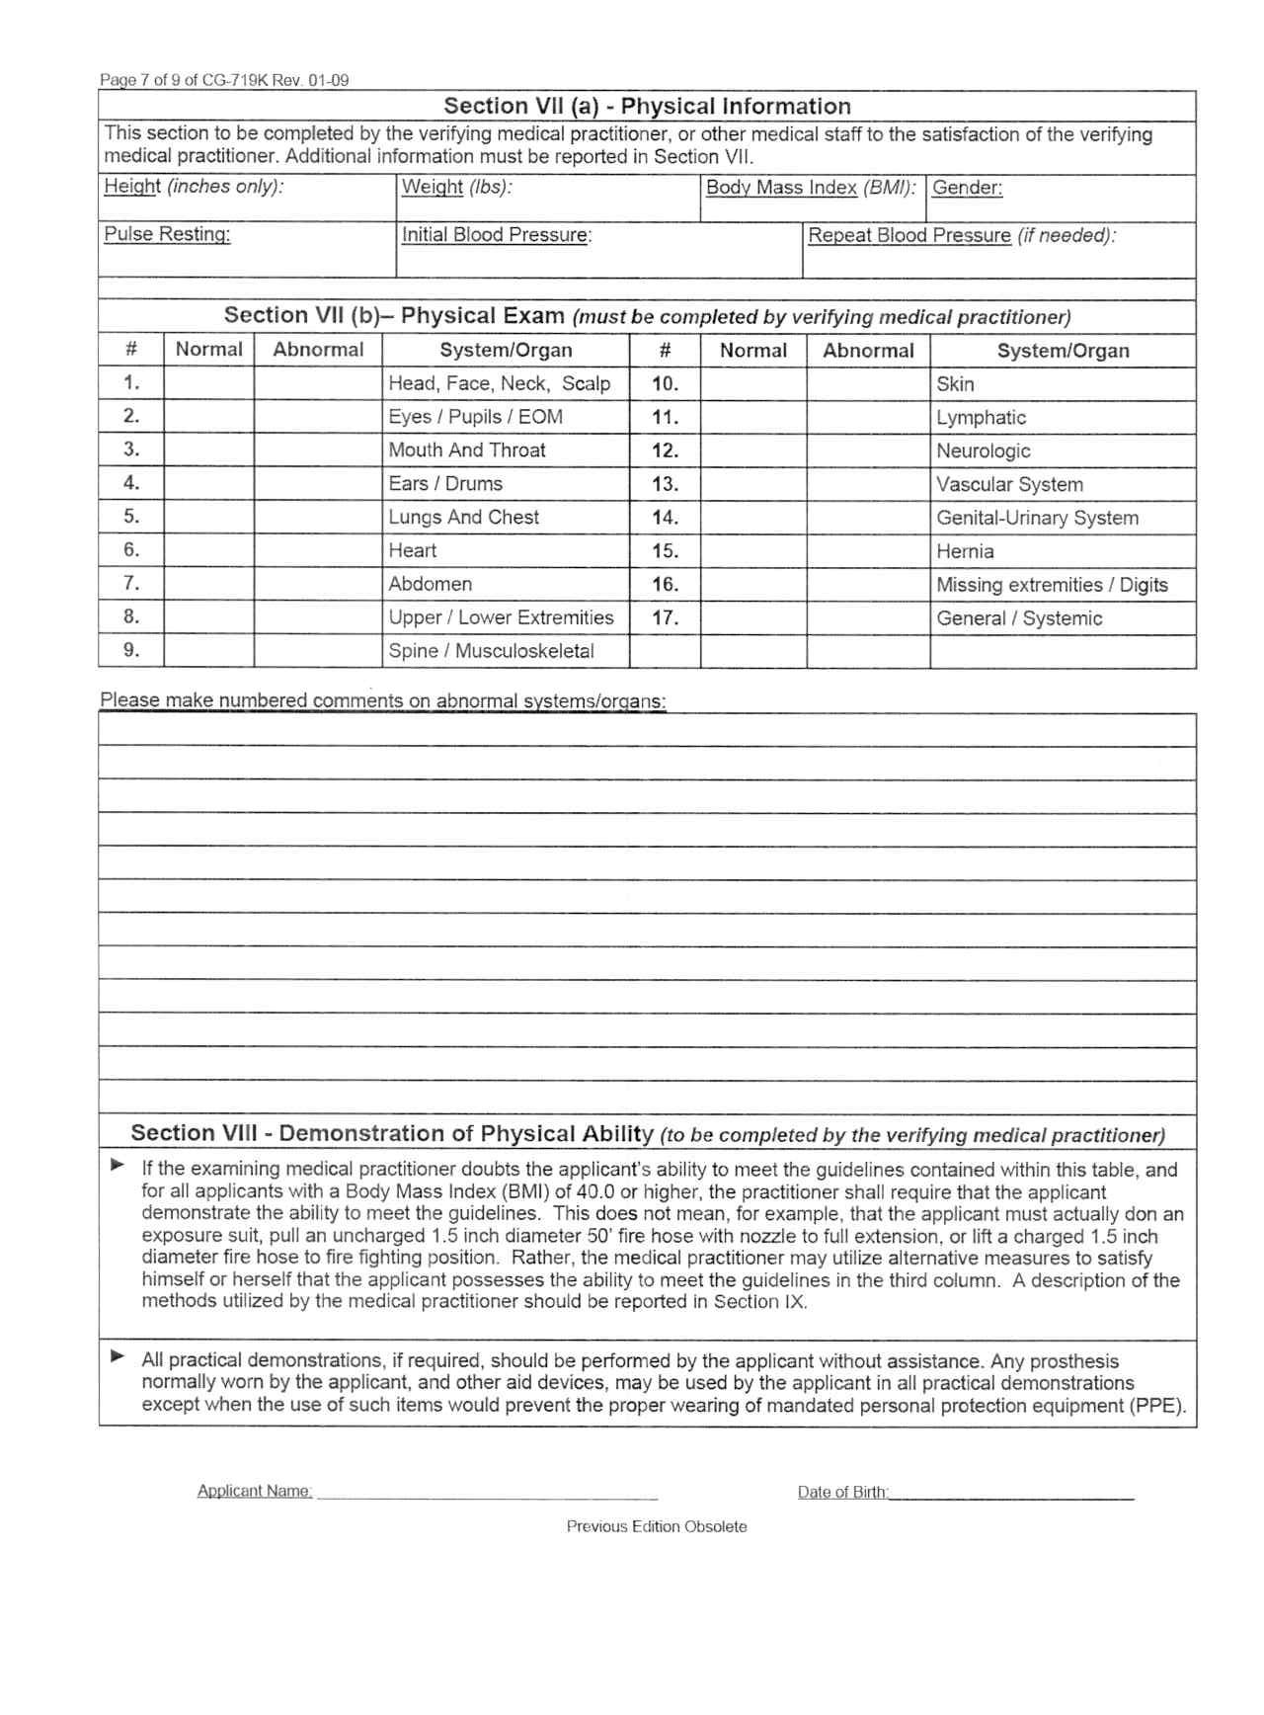
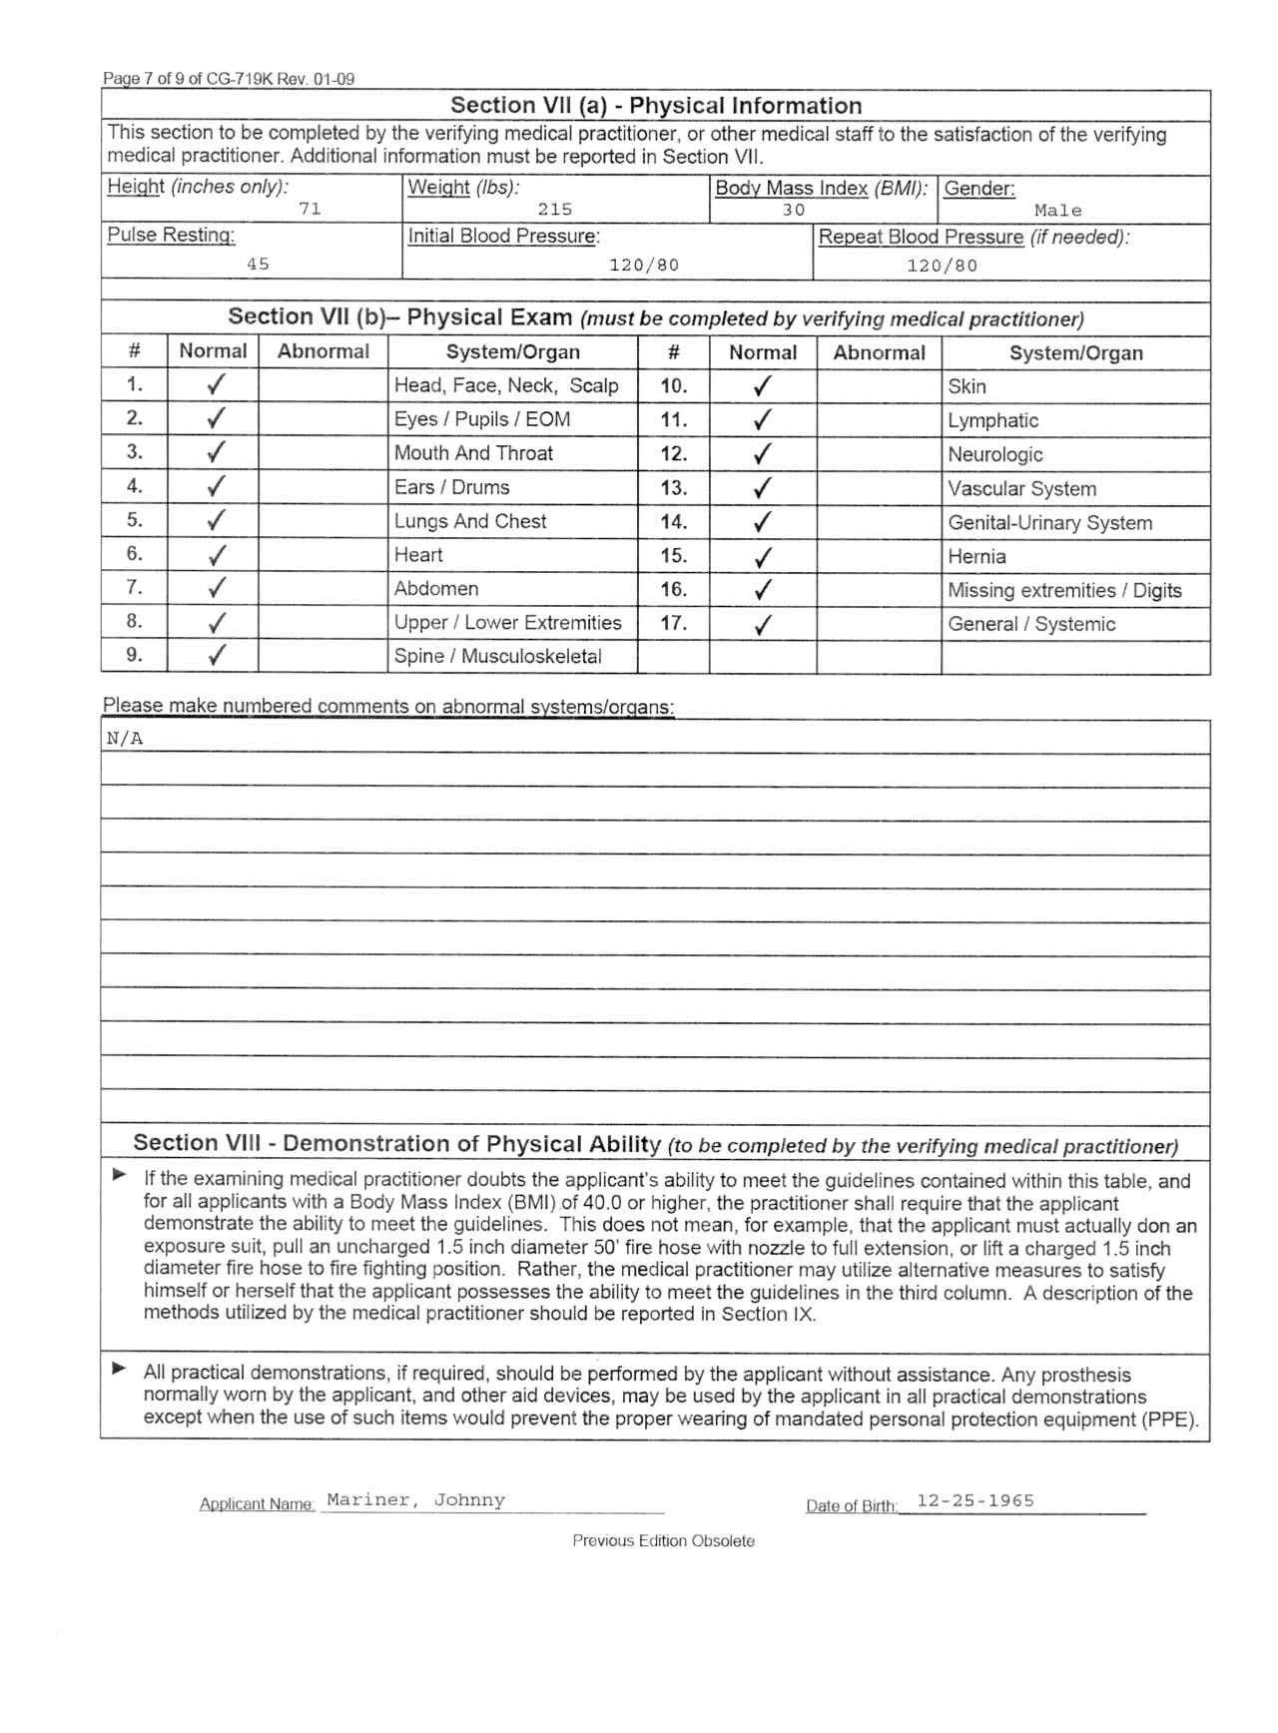
MANDATORY:
Ensure all blocks are completed!
Signed and dated (within 12months) by physician
If missing any of the above, DO NOT SEND
Can’t accept the application without it!

Slide 15
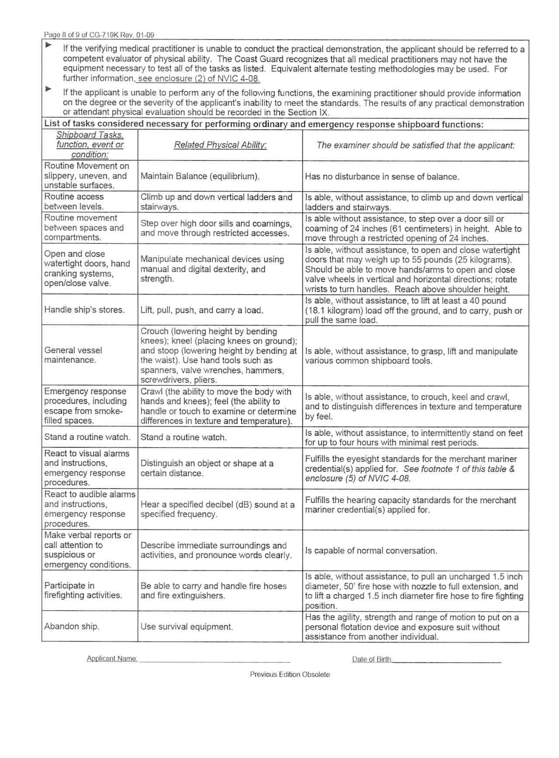
MANDATORY:
Ensure all blocks are completed!
Signed and dated (within 12months) by physician
If missing any of the above, DO NOT SEND
Can’t accept the application without it!

Slide 16
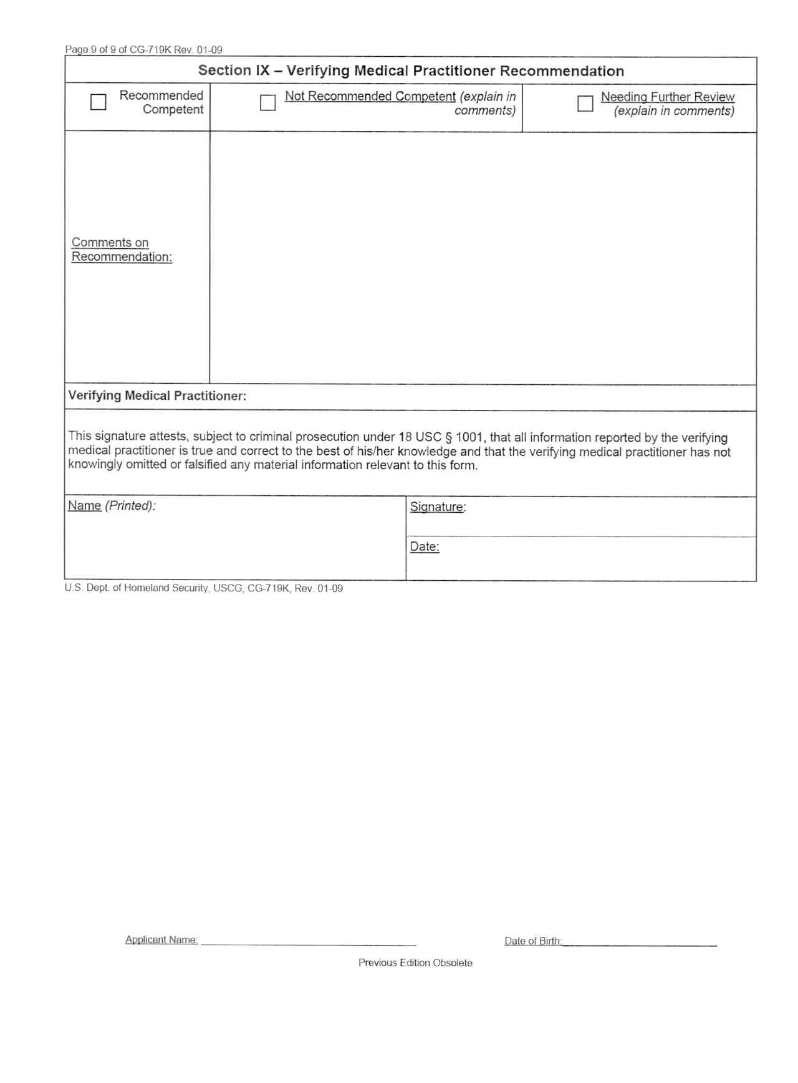
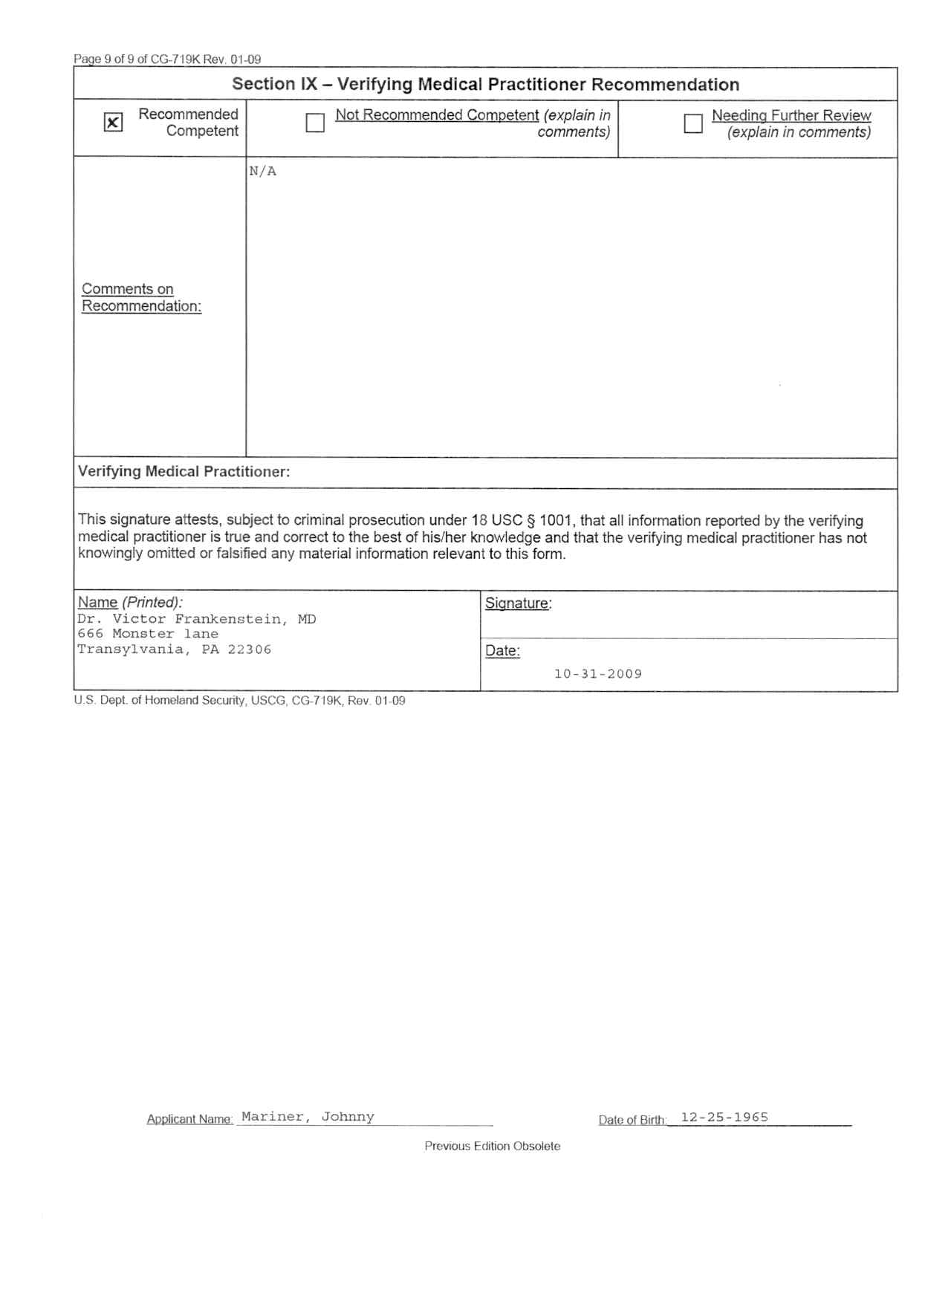
MANDATORY:
Ensure all blocks are completed!
Signed and dated (within 12months) by physician
If missing any of the above, DO NOT SEND
Victor Frankenstein
Can’t accept the application without it!
719K (Old)

Slide 17
D r u g
Letter
Each application must include a drug letter stating the following:
“This letter will certify that the person listed with, during the previous 185 days been subject
to a random testing program required by 46 CFR
§16.230 for at least 60 days and did not fail
or refuse to participate in a chemical test
for dangerous drugs required by this part.”
SUNY Maritime College will generate this letter, signed by the Commandant of Cadets, if this can be said about you.
Exceptions are if you were on a LOA or out on Cadet Shipping. Then…

Slide 18
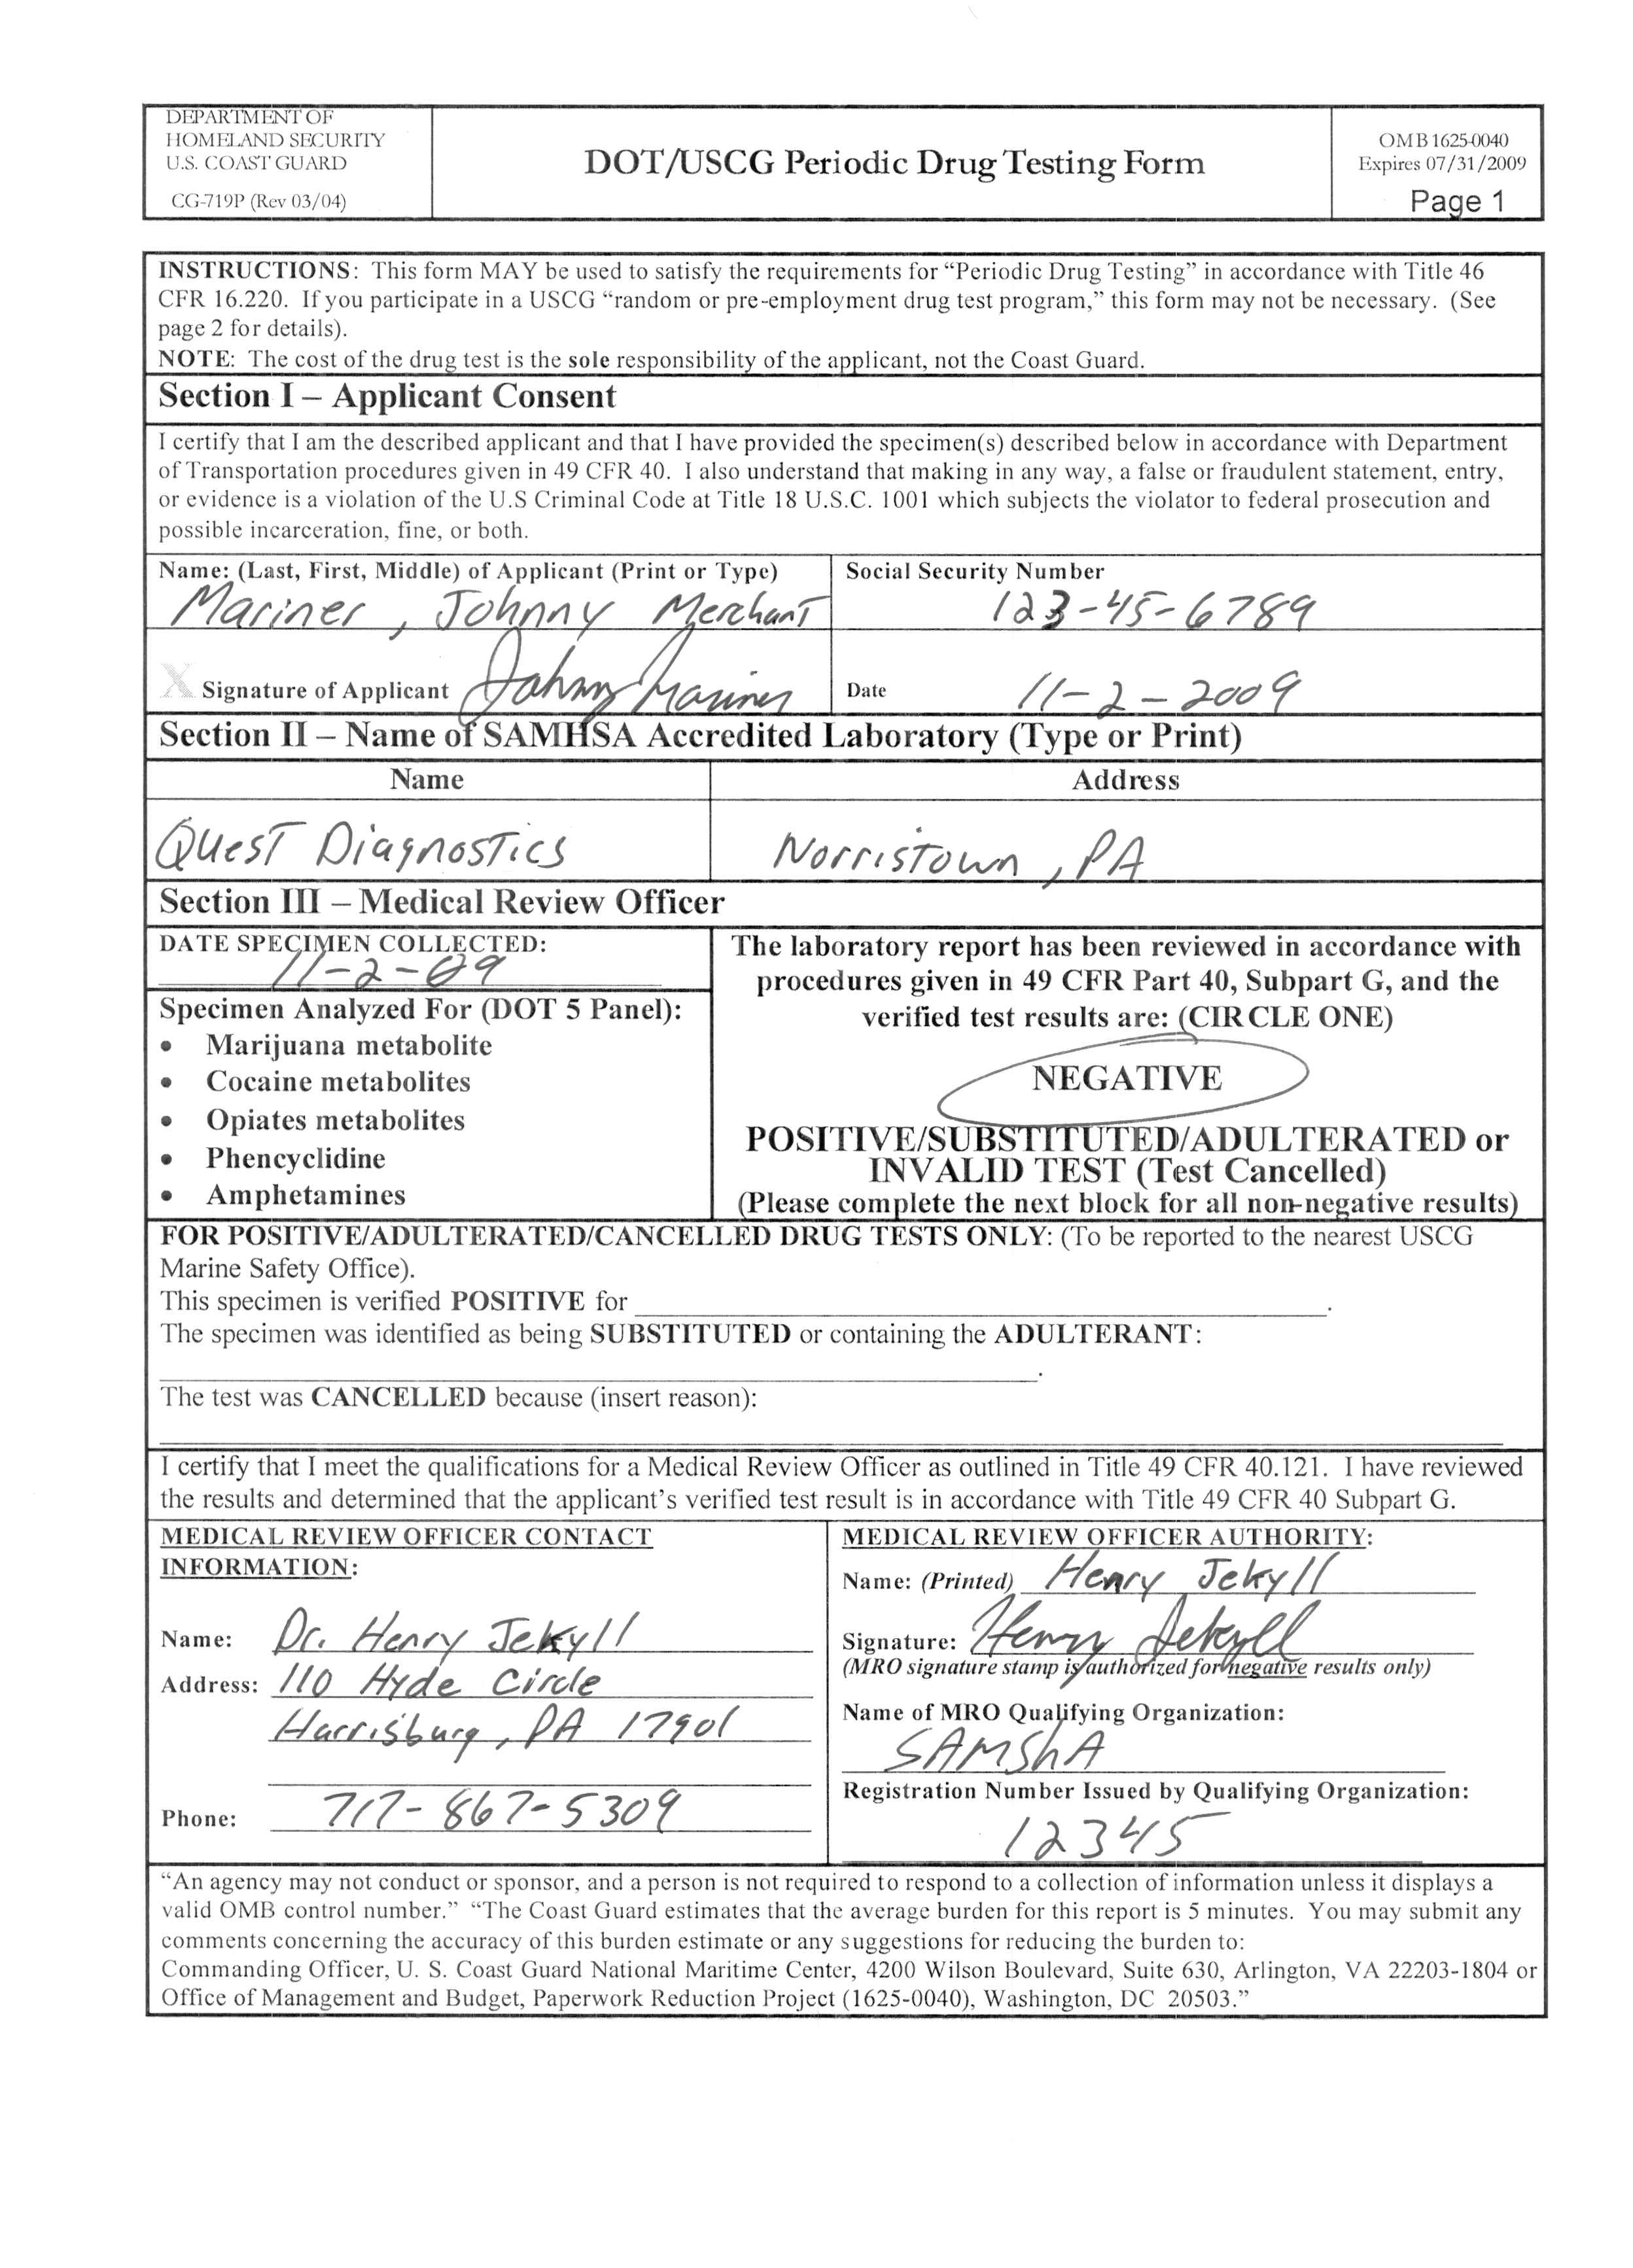
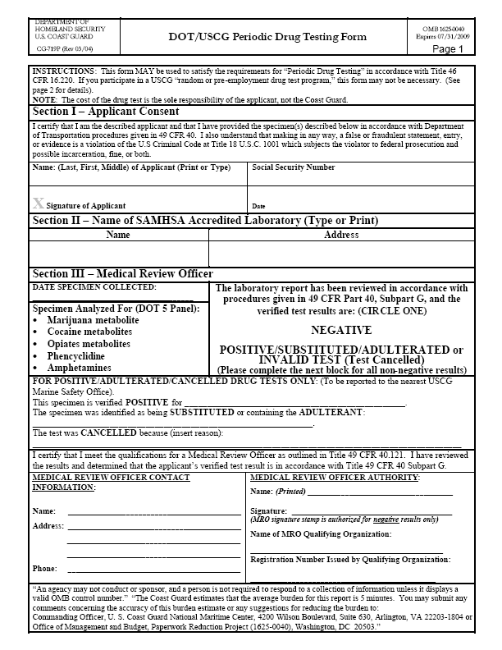
May be a form from a Testing facility
If missing any of the above,
  DO NOT SEND
MRO Verification sites:
http://www.aamro.com/
ttps://secure.bcentralhost.com/
  mrocc.org/surch.asp
http://www.uscg.mil/nmc/drug_testing.asp

Slide 19
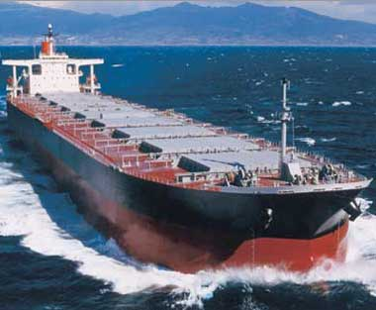
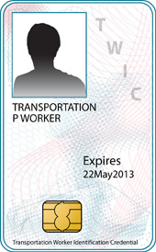
TWIC
Need
color copy of the front AND back of card!
Can’t accept the application without it!
Must certify with TSA as Merchant Mariner
https://twicprogram.tsa.dhs.gov/TWICWebApp/StatusCheckPrep.do
TSA Help Desk: 1-866-347-8942

Slide 20
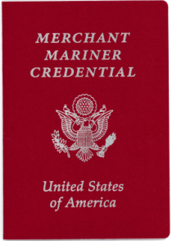
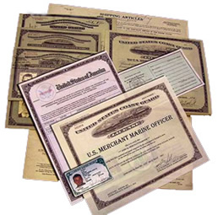
Copies of Credentials Held
Need color copy of picture page to signature page.
If you have an MMC, I do not need proof of citizenship…

Slide 21
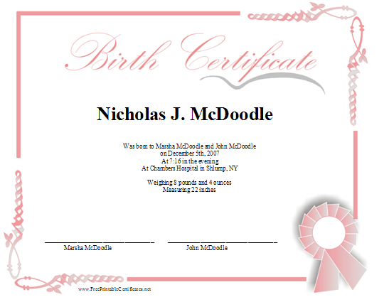
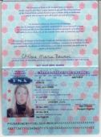
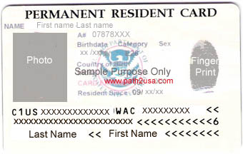
PROOF of CITIZENSHIP
Valid Passport
U. S.
Birth
Certificate
I-551 Alien Permanent Resident Card
Foreign Nationals must present both

Slide 22
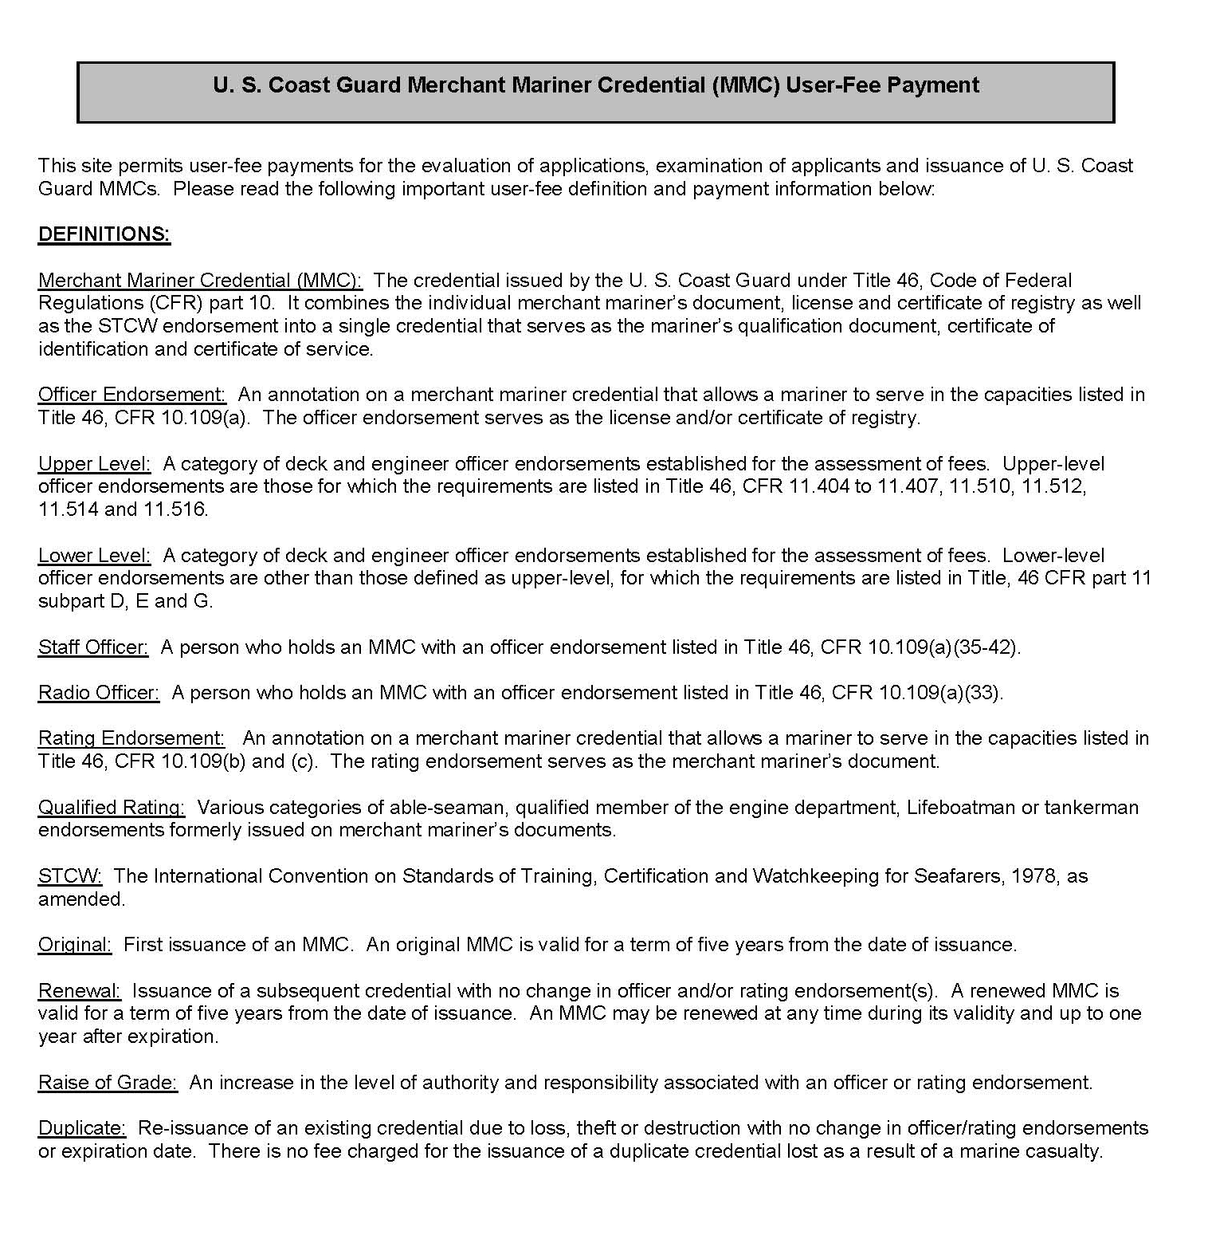

Fees
Use of PAY.gov is mandatory for this program
Show PAY.gov

Slide 23
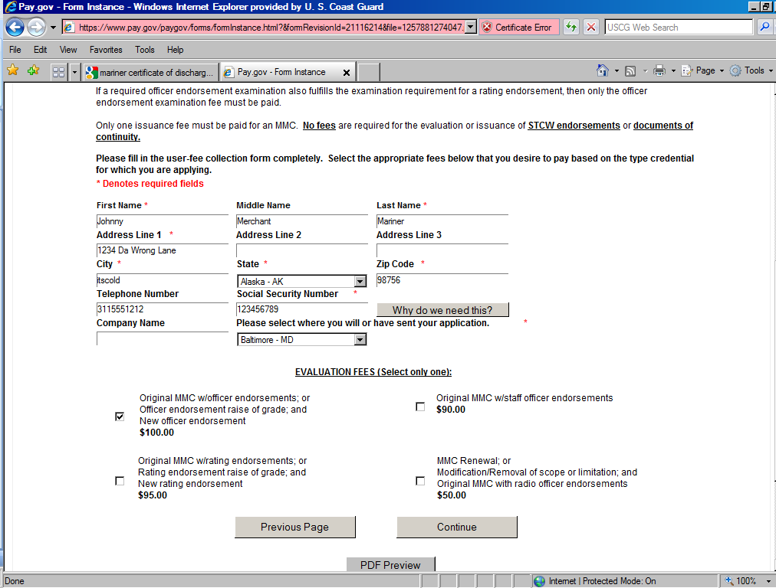
New York

Slide 24
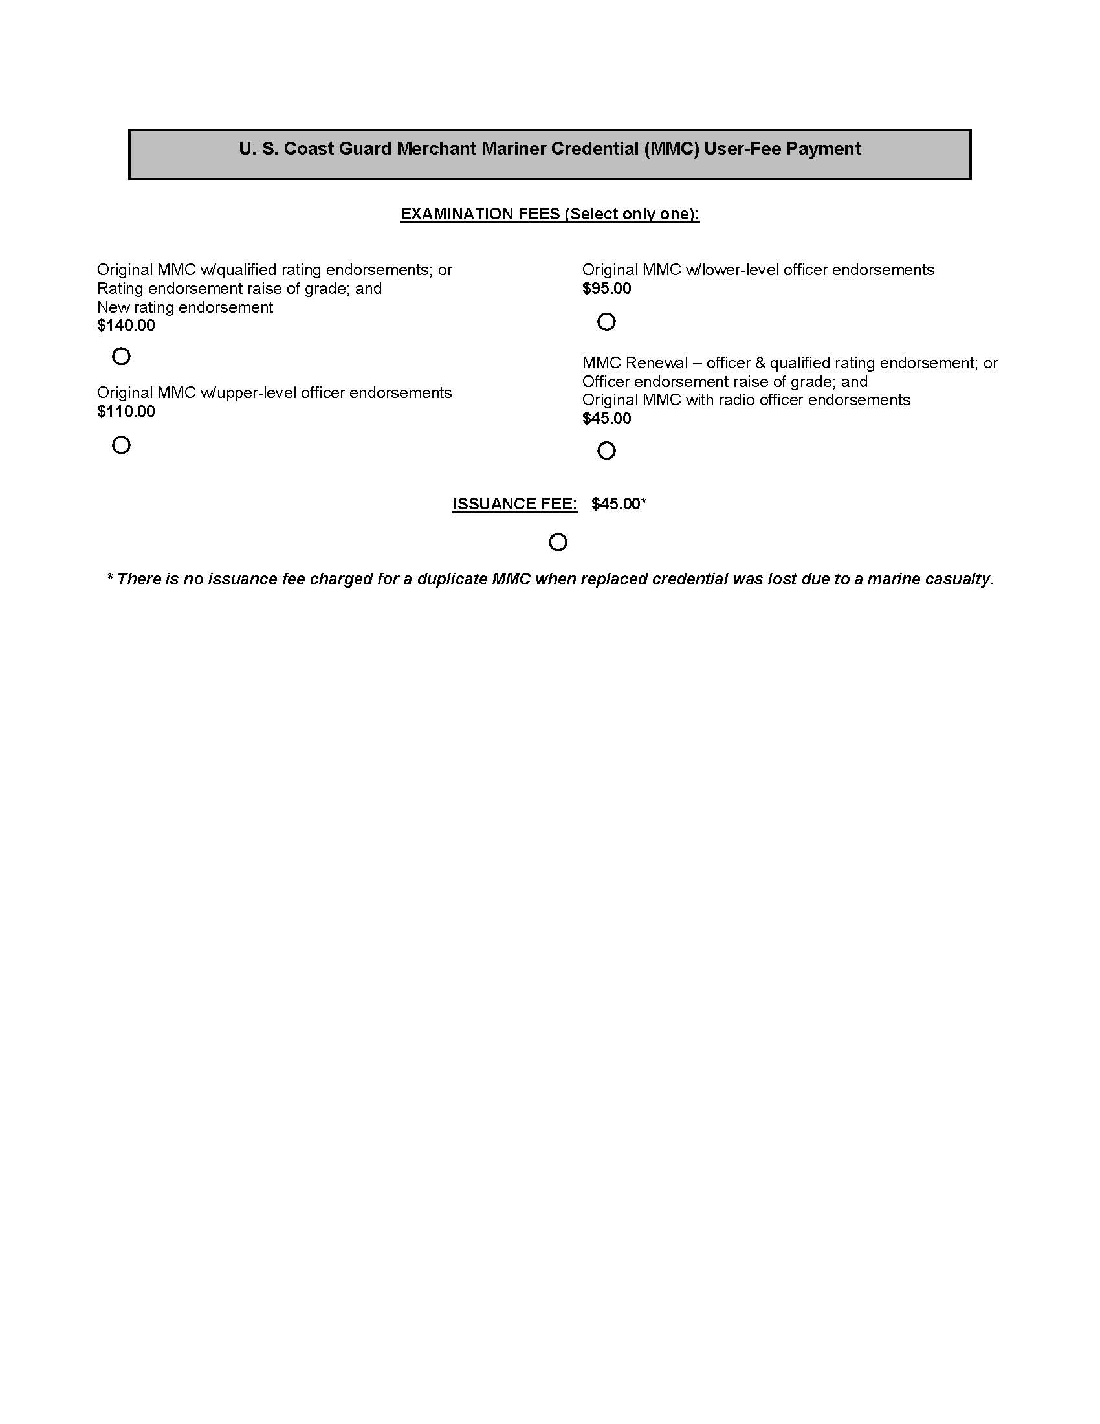
Fees
x
x

Slide 25
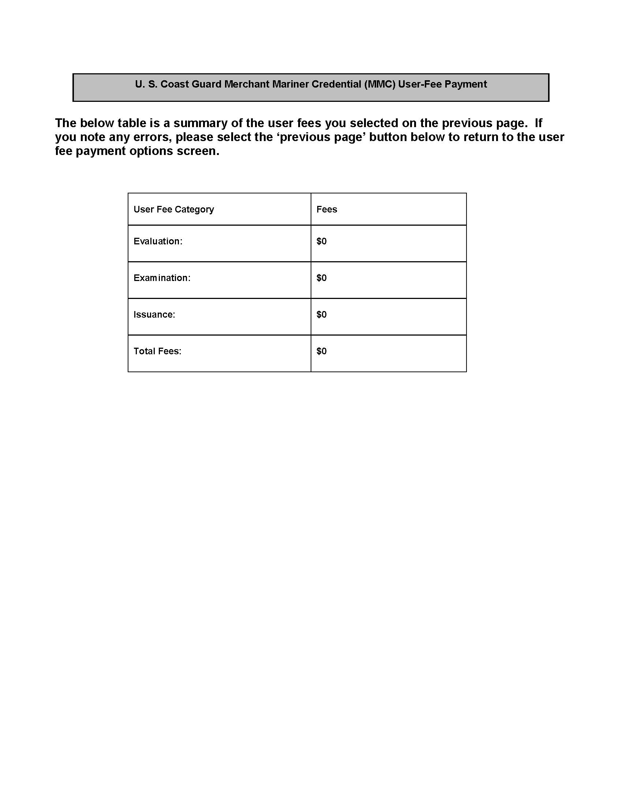
Fees
$100
$110
$45
$255
**It is important to note that the NMC is unable to process incremental fee payments. If the mariner pays the incorrect fee, the whole fee must be refunded, and a new transaction initiated.

Slide 26
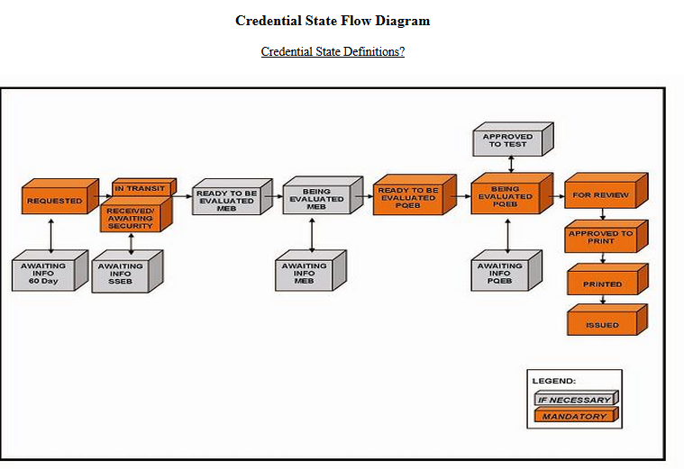
As your application goes through the vetting process at the NMC level, you will receive automated emails from them letting you know what step your application is currently in. If Amplifying Information (AI) is requested that requires action on your part, you will also receive a hard copy in the mail from the NMC to your home address. Please contact the License Department for guidance if AI is needed.

Slide 27
Degree Audit
Please print out a copy of your degree curriculum:
  Go to Maritime’s homepage
  Click on Academics
  Click on College Catalog
  Scroll to Degree Curricula
  Click on the Degree Curricula for the year you entered Maritime
  Print out

Slide 28
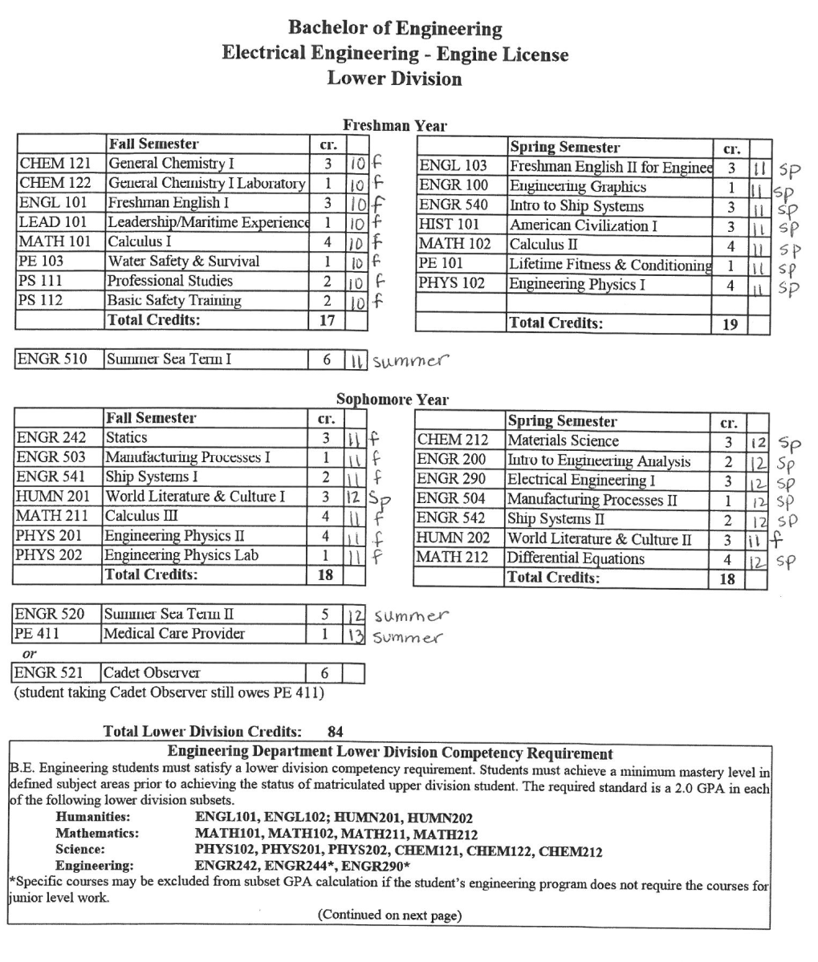
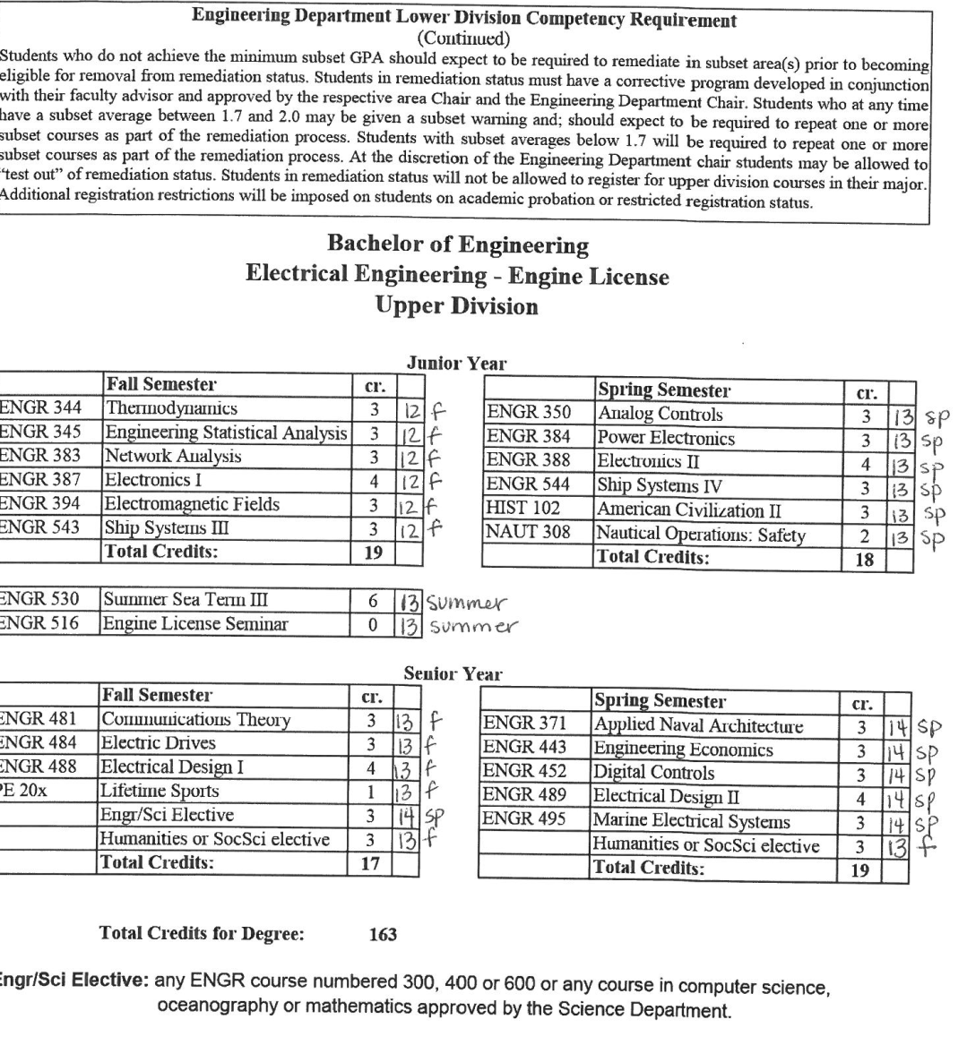
Degree Audit

Slide 29
Sea Time
Deck
  Training Ship / Commercial Vessels
    At least 300 days
  In-Port Watchkeeping & Maintenance
    NMT 30 days
    (4 TSES Maintenance Modules)
  Simulator Training
    NMT 30 days
  Total
    360 days
Engine
  Training Ship / Commercial Vessels
    At least 283 days
  Workshop Skills
    Shore-based labs (Engr 503, Engr 504, Engr 540, Engr 543) = 47 days
  4 TSES Maintenance Modules
    30 days
  Total
    360 days

Slide 30
Important Expiration Dates & Information
1. The following expiration dates are extremely important to keep in mind:
  Approval to Test (ATT) status lasts for one year.
  Exam Scores last for one year.
2. You may not sit for license until you:
  Have an ATT status
  You have passed Seminar AND
  You are within 6 months of graduation
Before a license can be released, the following must be verified:
  CPR & 1st Aid – date is within one year of application
  Flashing Light – date is within one year of passing exam
  PS 112 - BST – course completion date not more than (NMT) 5 years from graduation date
  Naut 308 - Advanced Firefighting – course completion date NMT 5 years from graduation date
  Radar – Navg 312 & Naut 315 – course completion date NMT than five years from graduation date
  Must have a copy of FCC license in file

Slide 31
License Website
Access the website by following these instructions:
www.sunymaritime.edu
Click on Student Affairs
Click on Coast Guard Licensing
Scroll down and look for the forms
The application is under the middle picture at the bottom of the page
The guidance document is under the left picture at the bottom of the page

Slide 32
USCG Licensing Meeting
Date: January 22, 2014
Full Name: _________________________
Last 4 of SSN: ______________________
Deck or Engine (circle one)
Anticipated Graduation Date: Sept 2014
Possess an MMC? Yes or No (circle one)

Slide 33
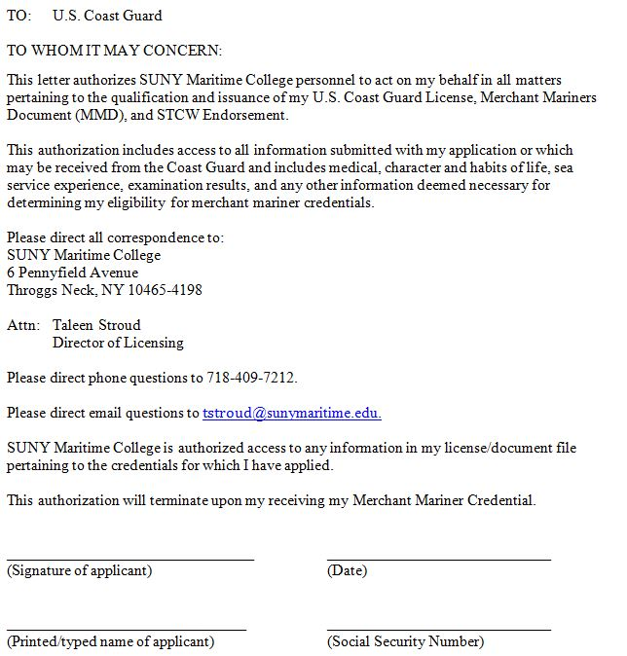
Third
Party Release
Must sign and turn in this form today!!

Slide 34
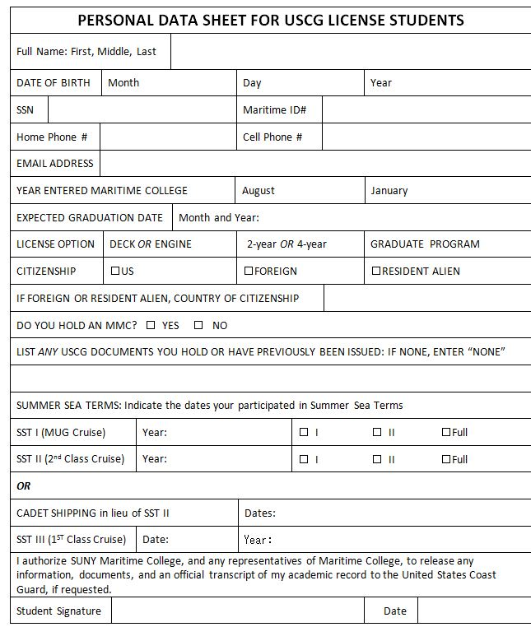
PDS
Must fill
out and
turn in today!!

Slide 35
APPLICATION DEADLINE DATE
Bring completed application packet to my office:
1st Floor Baylis Hall, Student Affairs
9:00 – 5:00 Monday – Friday
no later than
JANUARY 30, 2014

